Slide 1
Goal 1 The Autonomous Compliance Sentinel Data analysis · Planning · Architecture · Regulatory matters

Slide 2
Agenda
01
Project idea
06
Step 3: Architecture
02
Data basis: two real-world sources
07
Step 4: Regulatory matters
03
The Task
04
Step 1: analysis
05
Step 2: Planning

Slide 3
Project idea
Autonomous Compliance Sentinel, a responsible AI agent that
automatically monitors project proposals in Confluence/Jira,
checks them against internal Responsible AI guidelines,
identifies ‘ethical red flags’ (e.g. data without a legal basis),
suggests specific corrections and following human approval – updates the documents accordingly. Objective: To transform compliance checks from a manual bottleneck into a scalable, auditable safeguard.

Slide 4
Data basis: two combined real-world sources
Kaggle Jira-Dataset (cesaranasco/jira-dataset; 49,000 genuine issues)^{1 - GFG_FINAL.csv} provides actual details: issue type, status and the actual issue title
The PROMISE / NFR-Dataset (969 real-world software requirements, 47 projects)² provides the actual requirements text + highlights some of the red flags:
Security (SE) → RAI-04 Security
Legal (L) → RAI-01 Data Protection
The Jira dataset does not include an ethical dimension; this is provided by PROMISE/NFR. As a result, some of the red flags are based on genuine, negated requirements rather than purely synthetic approaches.
¹Source https://www.kaggle.com/datasets/cesaranasco/jira-dataset ²Source https://raw.githubusercontent.com/AleksandarMitrevski/se-requirements-classification/master/1- exploratory-analysis/data/PROMISE_exp.csv https://github.com/AleksandarMitrevski/se-requirements-classification

Slide 5
The real NFR source (PROMISE)
Requirement Type
Functional Requirement (F)
Security (SE)
Usability (US)
Operability (O)
Performance (PE)
Look-and-feel (LF)
Availability (A)
Maintainability (MN)
Scalability (SC)
Fault Tolerance (FT)
Legal (L)
Portability (PO)

Slide 6
The Task
Generate 1,000 project proposals from the two sources
⅓ (333) contain red flags, ⅔ (667) are compliant
Compliant requirements = actual functional requirements + positive non-functional requirements
Why combine them?
Actual text + known truth (ground truth) for each application → measurable detection

Slide 7
The Red Flag Catalogue
Policy ID | Principle | Severity | Source
RAI-01 | Data Protection | High | real (NFR: Legal)
RAI-02 | Transparency | High | synthetic
RAI-03 | Fairness | High | synthetic
RAI-04 | Human Dignity / Vulnerable Groups | High | synthetic
RAI-05 | Prohibited Purpose | High | synthetic
RAI-06 | Security | Medium | real (NFR: Security)
RAI-07 | Human Oversight | Medium | synthetic
RAI-08 | Data minimisation | Medium | synthetic
RAI-09 | Explainability | Medium | synthetic

Slide 8
Data analysis Step
01

Slide 9
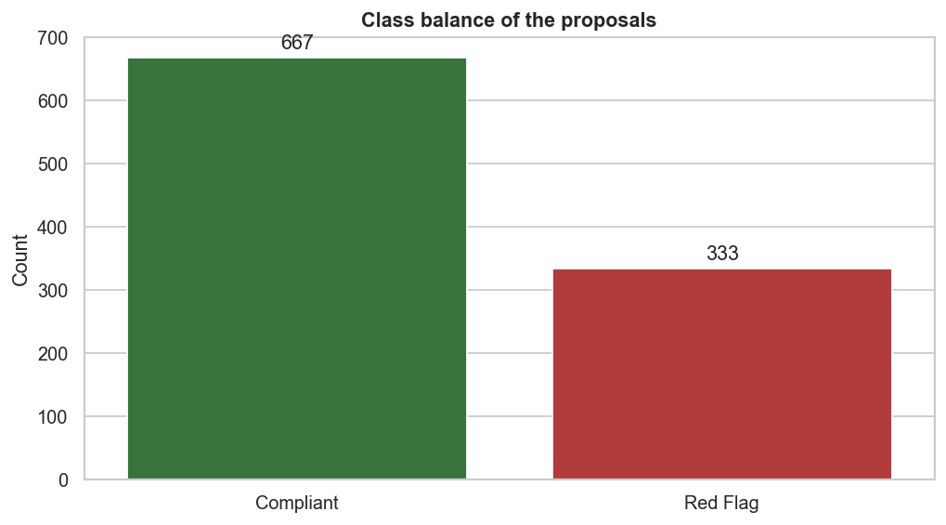
Step 1: Class balance

Slide 10
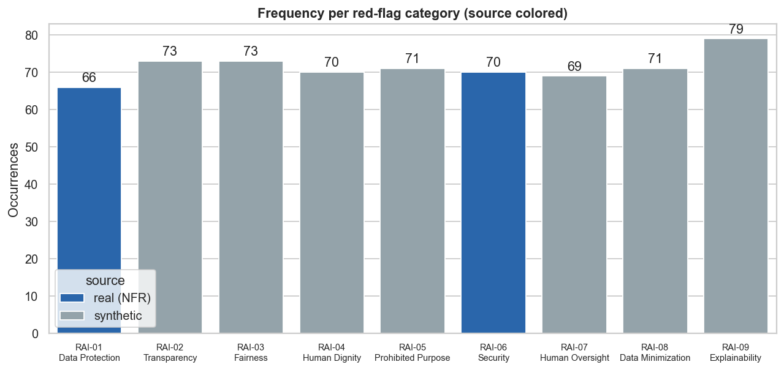
Step 1: Red-flag types & source

Slide 11
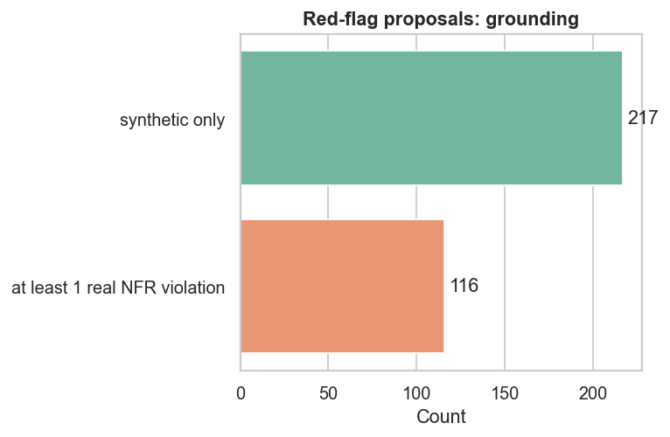
Step 1: Real implementation of the red flags

Slide 12
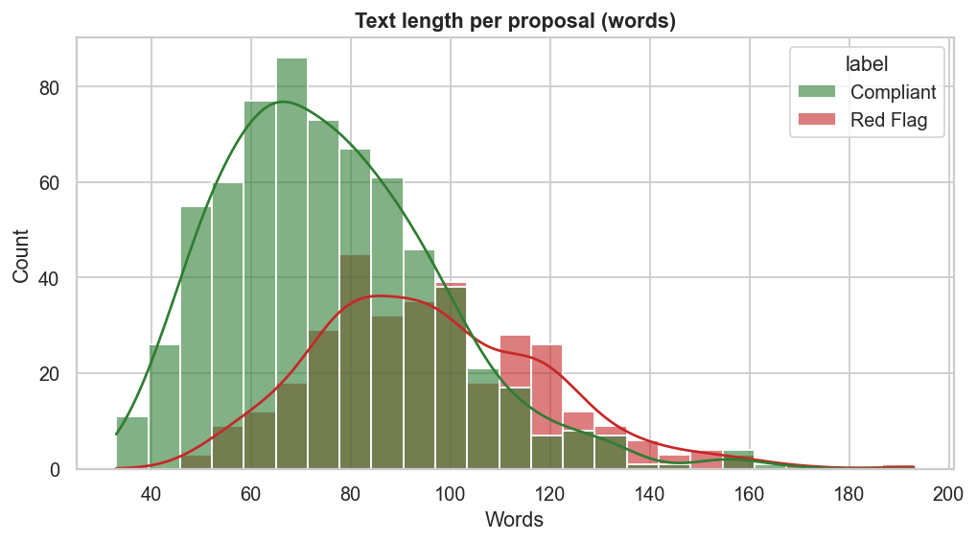
Step 1: Text length as a signal?

Slide 13
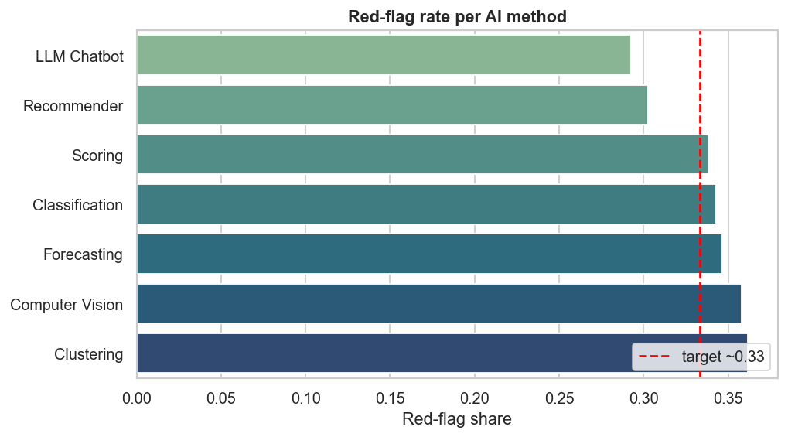
Step 1: Bias check using an AI-based method

Slide 14
Step 1: Fazit
1,000 requests from the Jira structure + actual PROMISE/NFR text
Red flags are partly grounded in reality (Security/Legal disputes this)
Slight class imbalance → choose the right metrics Focus on recall (a missed violation is more costly than a false alarm)
Text length (number of words per application): weak signal → semantic model required
No data bias according to the AI method; saved as proposals_1000.csv

Slide 15
Planning Step
02

Slide 16
Step 2: Planning
Woche | Arbeitspaket | Meilenstein
1 | Data (Jira+NFR) & EDA | Data set + analysis
2 | Baseline + Risk + Fairness | Benchmark metrics
3 | XAI + Tests (≥ 80 %) | Evaluation Report
4 | LLM-Agent + RAG + Write-Back | End-to-End-Demo
5 | Documentary + Pitch + Rehearsal | Conclusion

Slide 17
Architecture Step
03

Slide 18
Step 3: Architecture :-
Confluence / Jira
(Ingestion)
Pre-Processing
Policy-Retrieval (RAG)
Compliance-Engine
(Regeln + ML + LLM)
Write-Back + Audit-Log
Human-in-the-Loop-Gate
Remediation-Generator
Red-Flag-Klassifikation
+ XAI
If rejected at the Human-in-the-Loop-Gate, the proposal returns to Remediation-Generator for revision.

Slide 19
Step 3: Architecture Explained :-
How the system works, in plain terms:-
What it does in a sentence:
It reads proposals, checks them against our rules, explains any concerns, drafts a fix, and always waits for human approval. (With a full record of every step [logs] )
Steps:-
Ingestion :- reads proposals straight from Confluence/Jira, nothing changes for the teams writing them
Pre-Processing :- cleans and prepares the text for analysis
Policy-Retrieval :- pulls up only the internal rules that actually apply to this proposal
Compliance-Engine :- checks the proposal three different ways, so nothing slips through a single blind spot
Red-Flag Classification :- rates how serious an issue is, and explains why
Remediation-Generator :- drafts a concrete suggested fix
Human-in-the-Loop-Gate :- a person always approves before anything changes
Write-Back + Audit-Log :- the fix is saved back, with a full record of what happened

Slide 20
Step 3: The Autonomous Compliance Agent
Autonomous Compliance Agent
Policy Retrieval (RAG)
Compliance Engine
Red Flag Classification
Explainability (XAI)
Remediation Generation

Slide 21
Regulatory matters Step
04

Slide 22
Step 4: Regulatory matters
Rahmenwerk | Relevanz
EU AI Act | supporting, not high-risk; transparency & human oversight
DSGVO | Legal basis, data minimisation, data subjects’ rights
ISO/IEC 42001 | AI management system (governance, risk)
ISO/IEC 23894 | AI risk management
NIST AI RMF | Govern–Map–Measure–Manage

